Slide 1
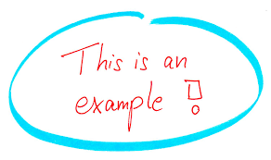
Let’s look at an example..
What happens when we return mutable values….

Slide 2
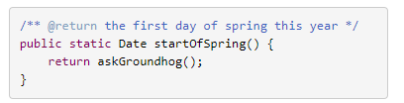
Returning mutable values
Let’s consider Date, one of the built-in Java classes. Date happens to be a mutable type.
Suppose we write a method that determines the first day of spring:
Here we’re using the well-known Groundhog algorithm for calculating when spring starts (Bill Murray, et al. Groundhog Day, 1993).

Slide 3
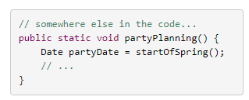
Returning mutable values
Clients start using this method, for example to plan their big parties:
All the code works and people are happy.
Now, independently, two things happen…

Slide 4
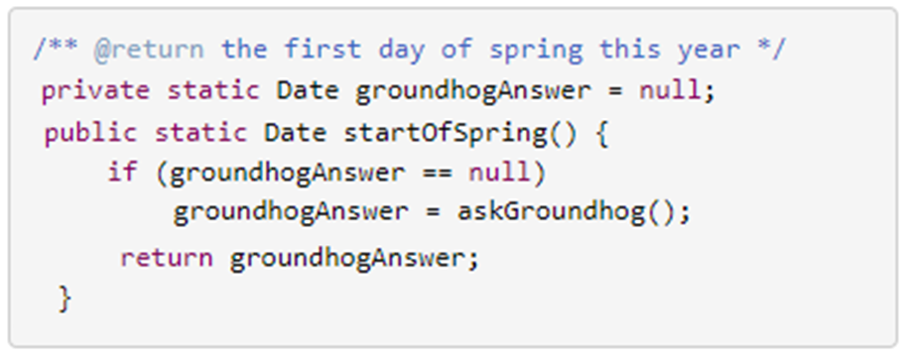
Returning mutable values
First:
The developer of startOfSpring() realises that the groundhog is starting to get annoyed from being constantly asked when spring will start.
So the code is rewritten to ask the groundhog at most once, and then cache the groundhog’s answer for future calls:

Slide 5
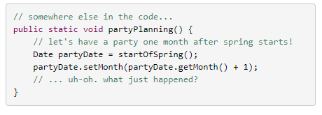
Returning mutable values
Second:
One of the clients of startOfSpring()decides that the actual first day of spring is too cold for the party, so the party will be exactly a month later instead:

Slide 6

Returning mutable values
What happens when these two decisions interact?
partyPlanning has accidently/unknowingly changed the date for start of spring!!
Why?
because partyDate and groundhogAnswer happen to point to the same mutable Date object.

Slide 7
Returning mutable values
Think about who will first discover this bug
will it be startOfSpring()?
Will it be partyPlanning()?
Or will it be some completely innocent third piece of code that also calls startOfSpring()?

Slide 8

Returning mutable values
This bug will probably not be discovered in partyPlanning() or startOfSpring() right away.
Instead, it will be some innocent piece of code that subsequently calls startOfSpring(), gets the wrong date back, and goes on to compute its own wrong answer.
In both examples, the problems would have been completely avoided if the list and the date had been immutable types.

Slide 9
Reference:
Joshua Bloch. 2018. Effective Java (3rd Edition). Prentice Hall PTR

Slide 10


Practical exercise for this week
See Instructions on Blackboard

